Slide 1

EXCEL MODULE 4 – LOOK UP FUNCTIONS
Enhancing Your Data Analysis Skills Pathway
2023

Slide 2
Agenda
VLOOKUP function
MATCH function
INDEX function
Exercise

Slide 3
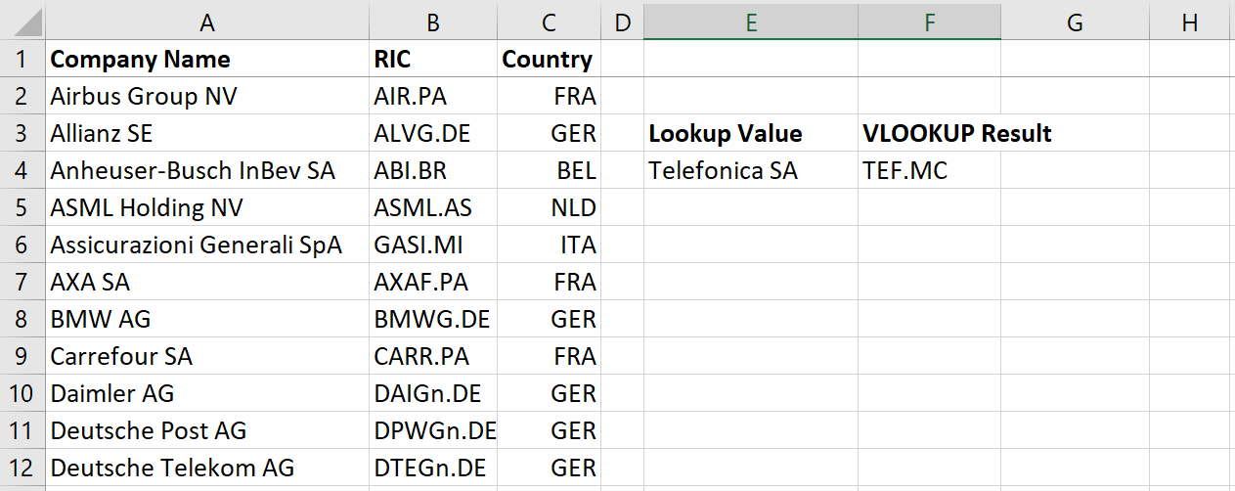
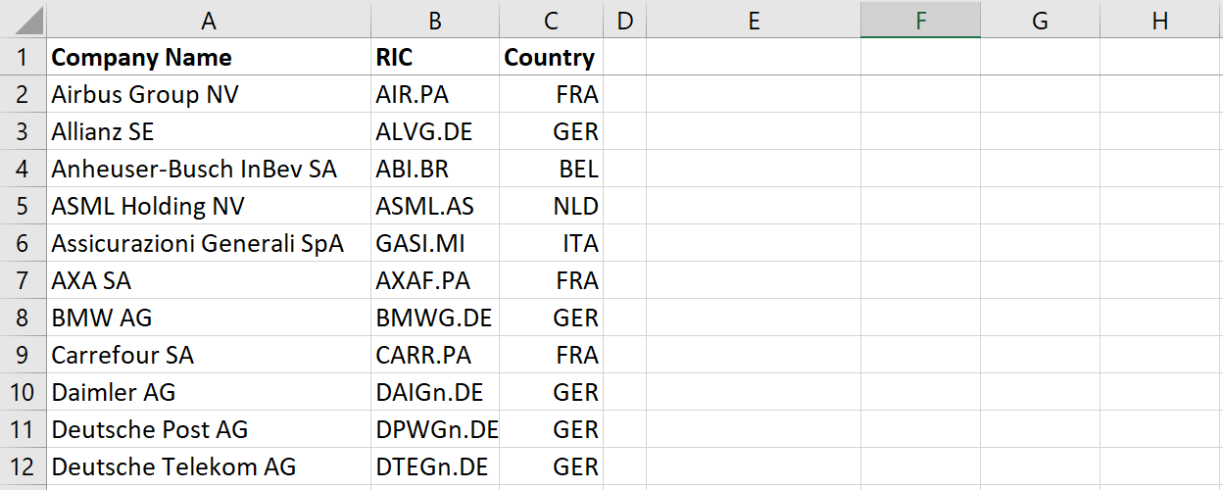
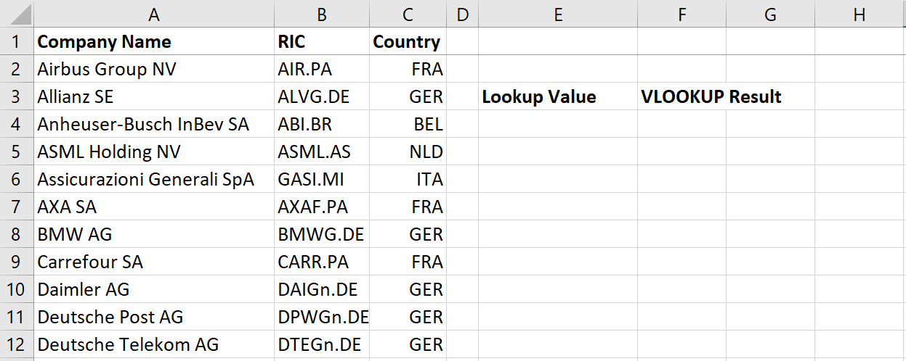
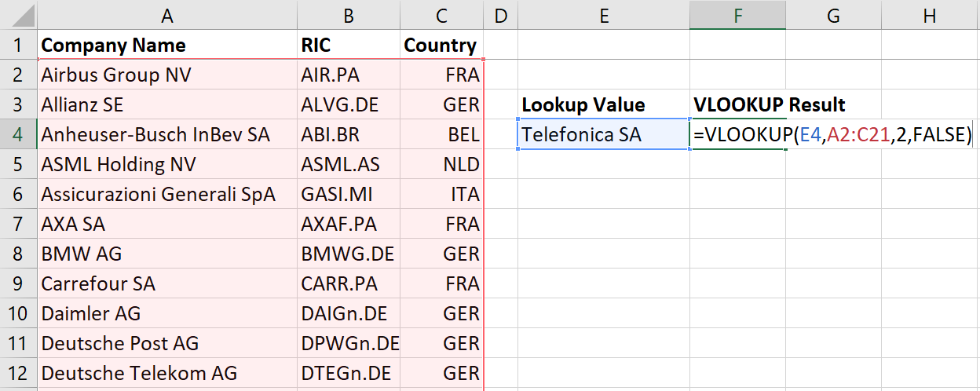
VLOOKUP
An exact or approximate match?
FALSE = exact match
What am I looking for?
Lookup Value
Where should I look?
Table Array
What should I return?
Column Index Number

Slide 4
MATCH
It is good Excel practice to avoid hardcoding values into a formula.
In order to build flexible lookup formulas we need the MATCH function.
With MATCH we can lookup the relative position of a value in an array.
=MATCH(lookup value, lookup array, match type)

Slide 5
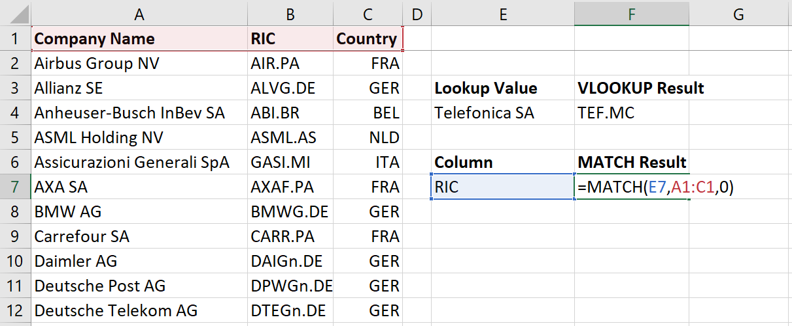
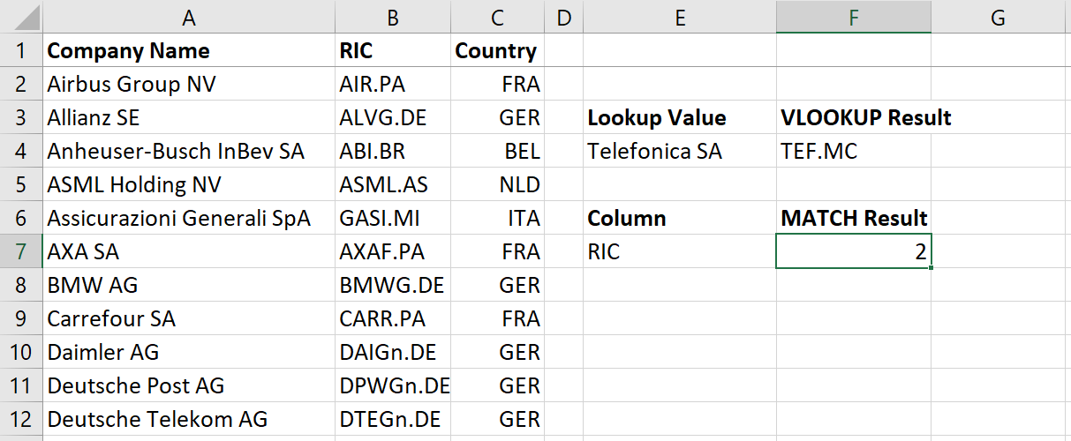
Match
What am I looking for?
Lookup Value
Where should I look?
Table Array
An exact or approximate match?
0 = exact match

Slide 6
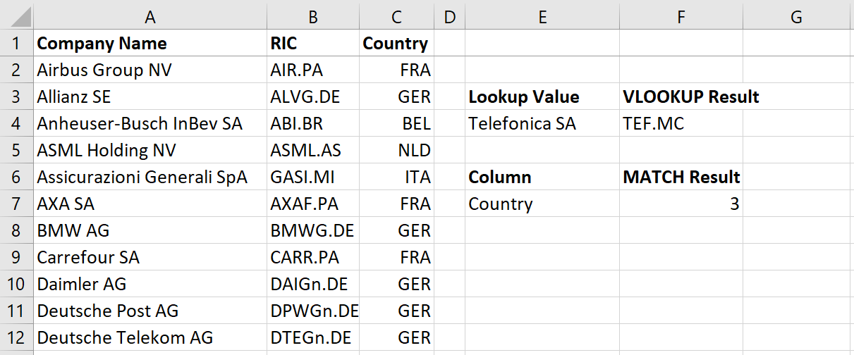
Match

Slide 7
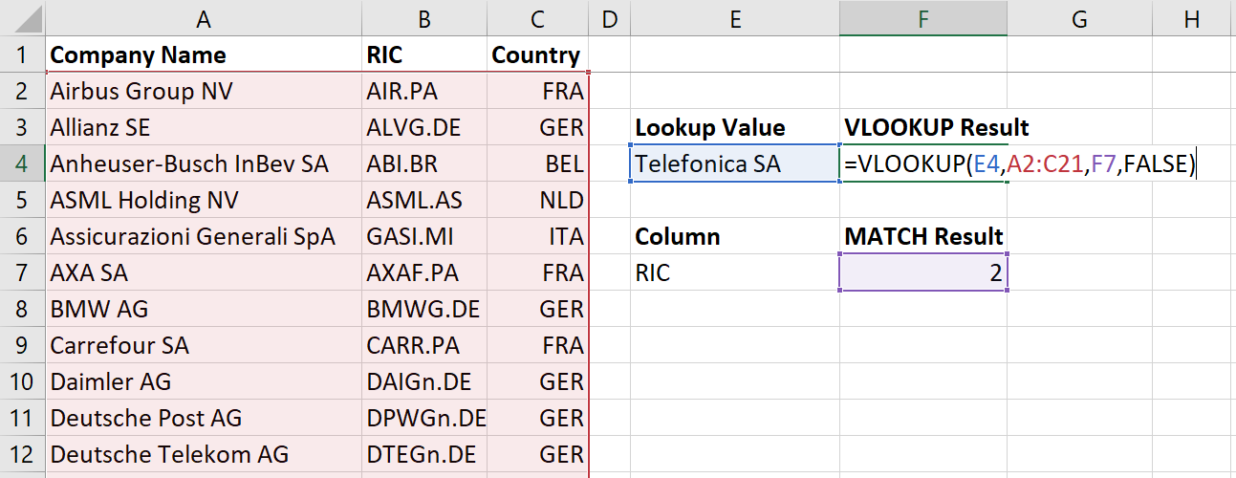
Vlookup + match
What am I looking for?
Lookup Value
Where should I look?
Table Array
What should I return?
Column Index Number

Slide 8
INDEX
VLOOKUP can only return values from columns on the right-hand of the lookup value.
The INDEX function is a more flexible lookup function.
Think of the INDEX function as having a map and giving coordinates to look for a specific value on the map.
=INDEX(lookup array, row number, column number)

Slide 9
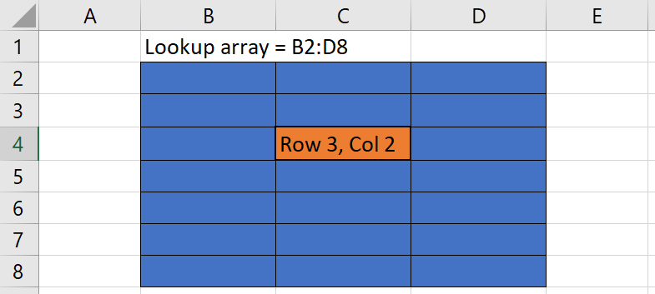
INDEX
=INDEX(B2:D8, 3, 2)

Slide 10
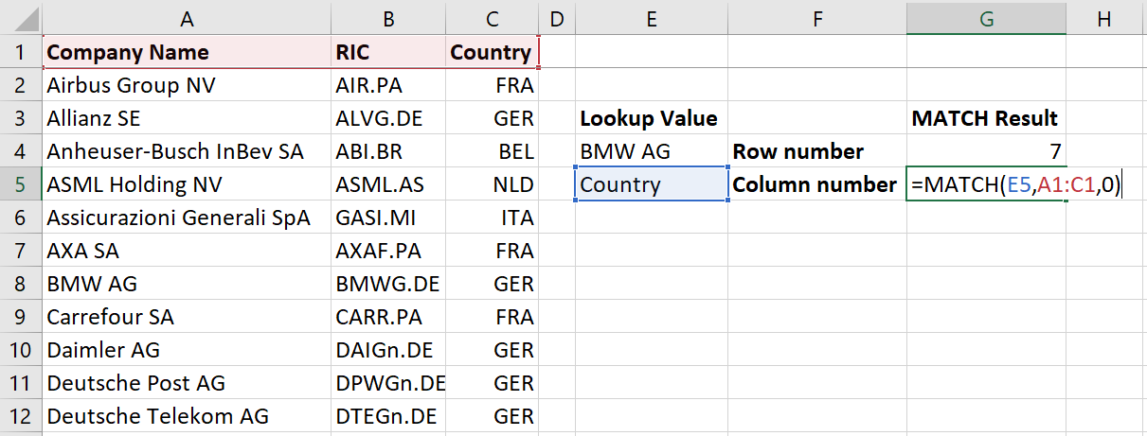
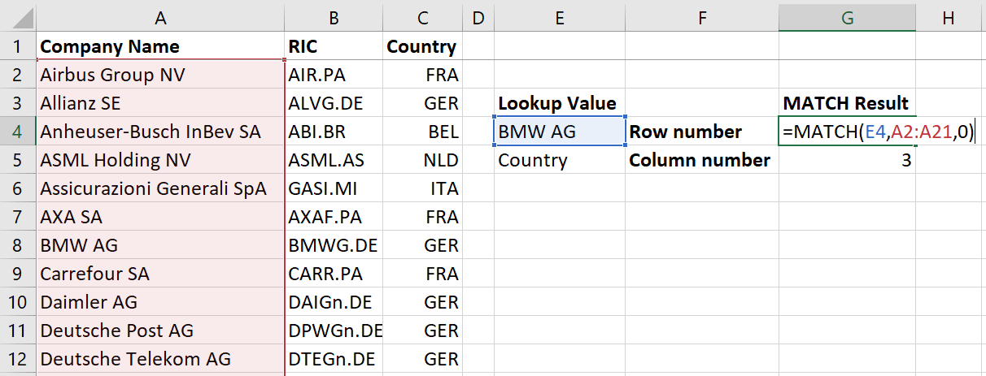
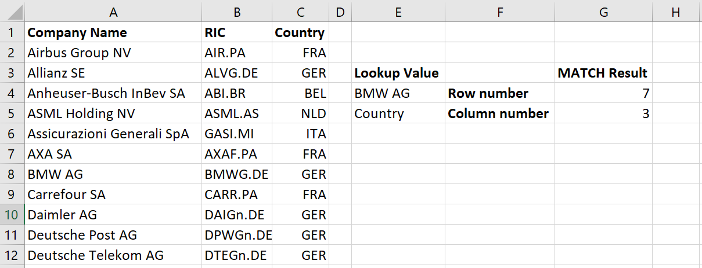
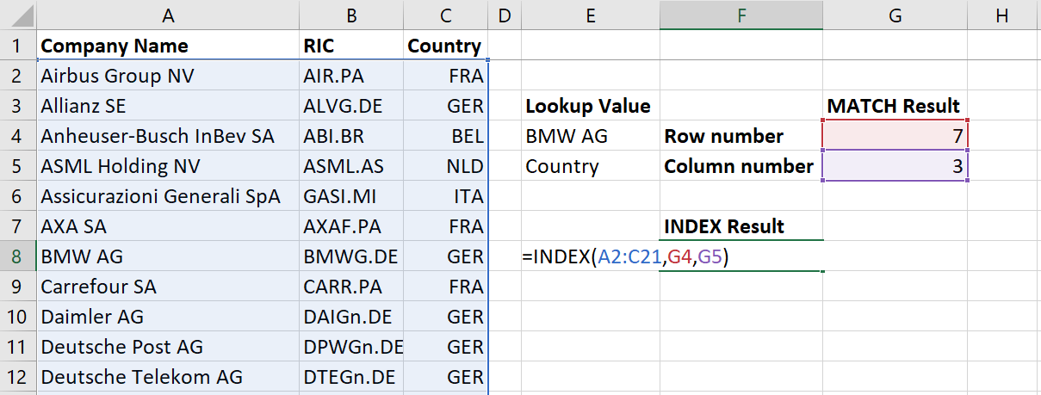
INDEX
Lookup Array
Column Number
Row Number

Slide 11
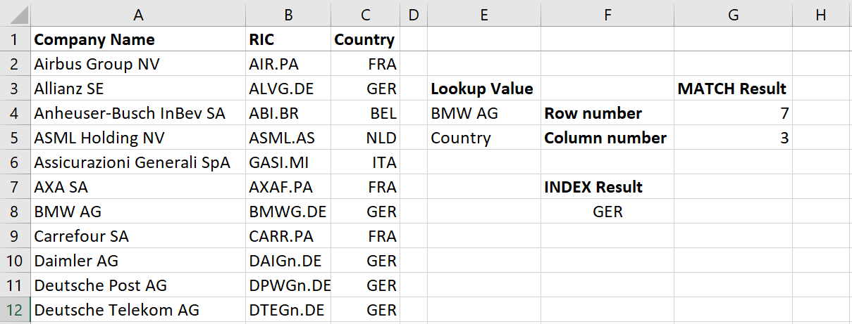
INDEX

Slide 12
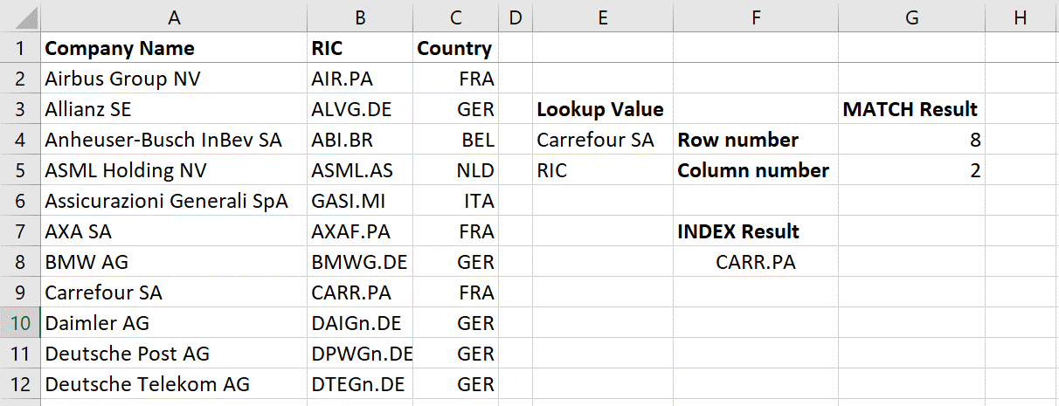
INDEX

